Slide 1
ASP.NET MVC CORE
Instructor: Edwin oduor

Slide 2

Quote of the day

Slide 3
Lesson objectives
WWW root Folder
Launch Setting File.json
Model View Controller (MVC)

Slide 4
Lesson pre-requisites
In order to take full advantage of this section you need to have the following;
Computer with Visual Studio Installed.
Stable Network Connection.

Slide 5
Training methods and extra readings
TRAINING METHODS FOR THIS LESSON
EXTRA READINGS
Lecturing Method – This is the main method of training to be adopted in this lesson with illustrations and practical coding examples.
Discussion Method - This method will be adopted periodically whereby learning will be derived principally from the students brainstorming together, rather than from the trainer. Three main types of discussions will be used:
Directed discussion
Developmental discussion
Problem-Solving discussion
Home and Learn C#

Slide 6
WWW ROOT FOLDER

Slide 7
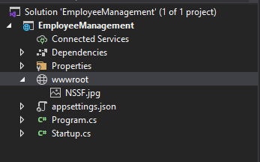
To serve static files i.e. HTML and Java script Files then the static files should be placed inside the WWW root folder. This folder is used to store the static files.
To create a www folder.
Employee Management (Name of the project). Right click on it >> New Folder, the folder name give it wwwroot.

Slide 8

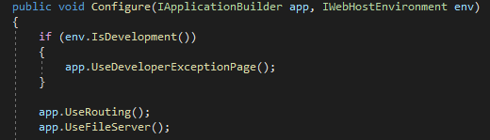
Inside wwwroot there is an image file, to access it on the browser will write the path of that image so that it can be displayed on the browser.
For it to be visible we need to tell our program that we want to access that image, hence in the Startup.cs we need to use the middle ware to access the image.

Slide 9
MODEL VIEW CONTROLLER

Slide 10
What is MVC – MVC stands for Model, View and Controller. This is an architecture that makes it possible to have separation of concerns.
When a user issues a request in their favorite browser it is the work of the Controller to handle the request made. The controller will interact with the model, the model is the one responsible with the data logic, data from the database. The model is the one that is going to interact with the database, to retrieve the data that the controller requested for. After retrieving the data, the model will get back to the controller, at this point the controller will interact with the view, so that the view displays the data on the browser. The work of the view is to represent the data, The view will then get back to the Controller and the controller will send back what the user requested to be viewed on the browser.

Slide 11
Diagram Explaining MVC
Model
View
User request
Controller

Slide 12
CONTROLLER

Slide 13
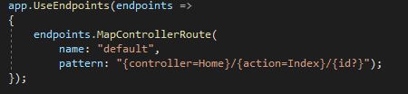
When a user issues a request on their favorite browser it is the controller that is going to respond to the request. The controller is going to respond to what has been written in the address bar by calling an action based on what is indicated on the address bar.
The question that we can ask our selves is how does the program know which controller to call given a scenario that there are many controllers? This is achieved by configuring the default Route, in this case a default controller that has been set is the one which will be called. In the code below the default has been set to use the Home controller and the Index Action. This is done in the startup.cs file.

Slide 14
VIEW

Slide 15
A View on the other hand is an HTML page that is used to display information/Data to the users of the System. For instance if we want to display list of customers, students etc. then a view has to be created for this purpose.

Slide 16
model

Slide 17
A model is a class that is responsible for storage and retrieval of data.
Will be talking more in details about Model Views and Controllers in-depth so that we can understand better about MVC.

